Slide 1
Learning Based Control Seminar
An image is worth 16 X 16 Words : Transformers for image recognition at scale
Ashwin Chakravartula
ashwin.chakravartula@rwth-aachen.de
13.11.2024

Slide 2
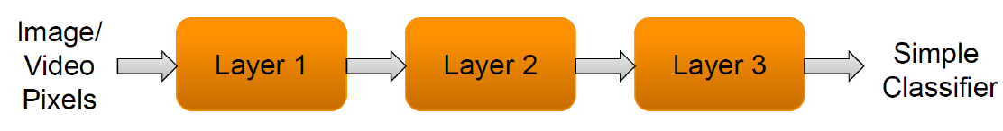
About vision related tasks
Vision-related tasks in Computer Vision aim to help machines interpret and understand visual information.
Consists of
Image Classification
Object Detection
Semantic Segmentation
Image generation
Video Understanding

Slide 3
Overview
Idea behind this paper
Building blocks
Experiment / Testing
Observation
Conclusion
Application of this research

Slide 4
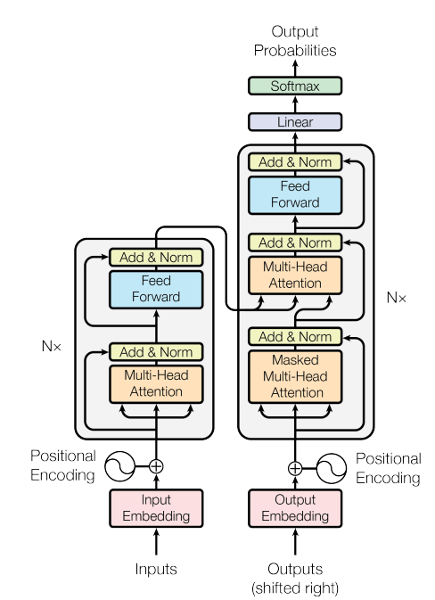
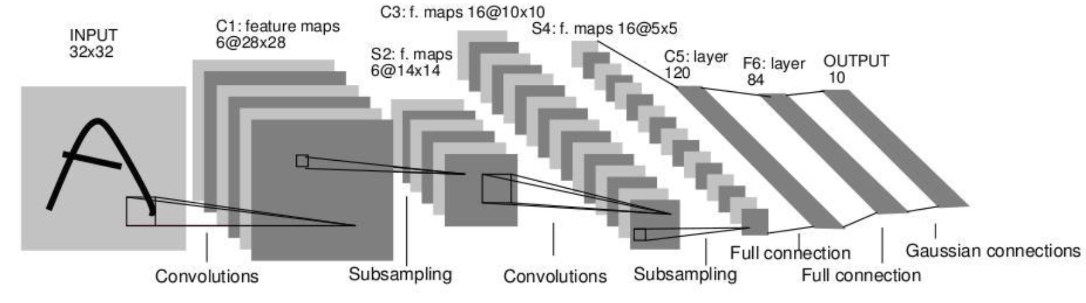
Idea behind this paper
For computer vision tasks, Convolutions are still in the mainstream
Transformers till now, were mostly used to aid or applied in conjunction with convolutional networks
The overall structure was still same as standard CNNs
Researchers try to show that reliance on CNN for vision related tasks not necessary
Transformers when pre-trained on large datasets can give better accuracy than CNNs for classification related tasks
Y. LeCun, L. Bottou, Y. Bengio, and P. Haffner, Gradient-based learning applied to
document recognition, Proceedings of the IEEE 86(11): 2278–2324, 1998
Vasawani et al, Attention is all you need, 31st Conference on Neural Information Processing Systems (NIPS 2017)
Notes:
Self-attention mechanisms, especially Transformers have become most-widely used model in the areas of Natural Language Processing.
Dominant approach is to pre-train the model with a large dataset of text and then fine-tune it on a smaller task-specific dataset.
Because of Transformers, it is now possible to train the model on huge datasets (having 100B parameters) in a computationally efficient way, also proving that Transformers are scalable.
Now slowing progressing towards identifying the gap, for computer vision tasks however, Convolutional networks are still used in the mainstream

Slide 5
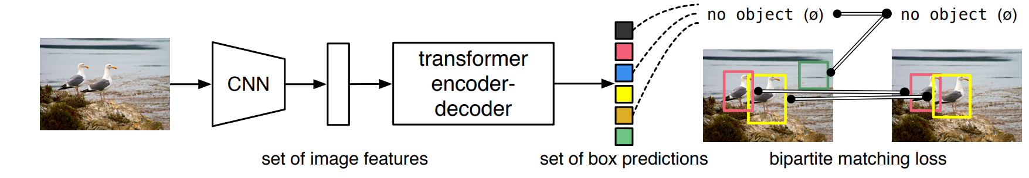
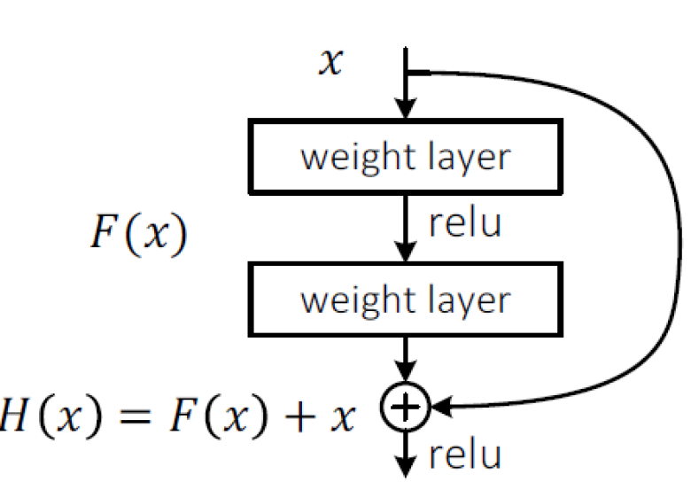
Idea behind this paper : Literature Gap
Carion et al, End-to-End Object Detection with Transformers, 2020
Researchers have used Transformers in addition to conventional CNNs and preserved the traditional structure for computer vision tasks, (not exactly replacing CNNs with something else)
Computation overhead of the vanilla transformer grows quadratically w.r.t. sequence length, acting as a bottle neck for transformers to handle long input sequences.
These models are theoretically efficient, but not scaled effectively on modern hardware accelerators due to the use of specialized attention patterns
Making ResNets still widely used model for performing computer vision tasks.
ResNet architecture
Notes:
Other researchers have tried to combine the CNN-like architecture with self-attentions following the scaling success of NLPs.
However, these models are only theoretically efficient, as they found out that it was not scaled effectively on modern hardware accelerators due to the use of specialized attention patterns.
Hence, for large scale training and image recognition tasks, ResNet like architectures were still state-of-the-art and widely used.
The authors in this paper experiment by directly applying transformer to the images, with very few modifications.

Slide 6
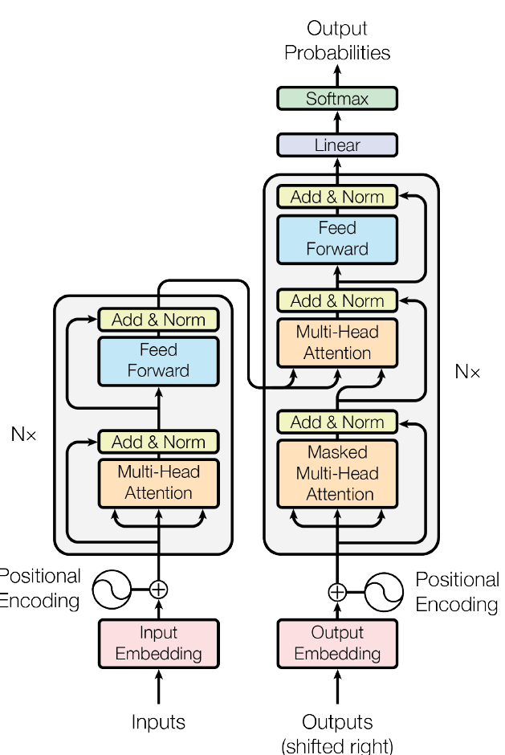
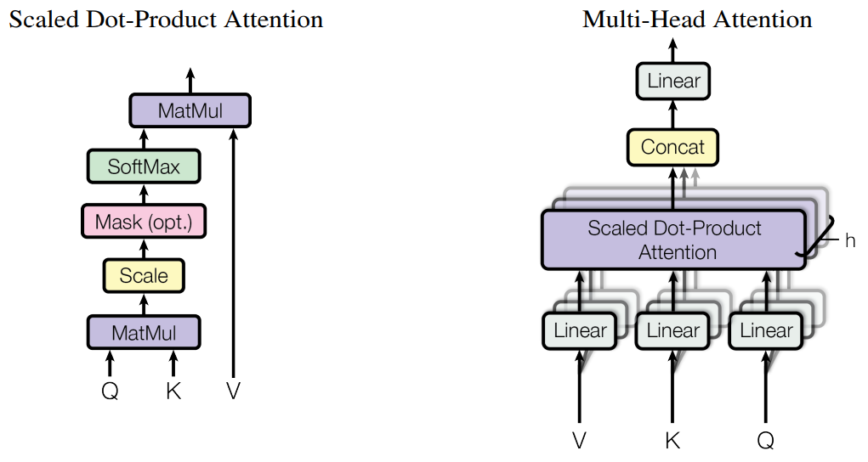
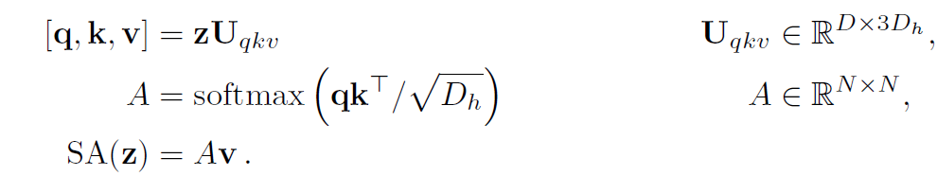
Building blocks of a ViT
Self attention mechanism
Transformer
Vasawani et al, Attention is all you need, NIPS 2017
Notes:
<Explain the transformer architecture>
It is a neural network design primarily for sequence-to-sequence tasks like language translation and text generation.
It uses self-attention mechanism to model dependencies between tokens in parallel
A Vanilla Transformer’s architecture consists of 6 layers of encoder-decoder layers
The sub-layers of encoder layer are
Multi-head self attention
Position wise feed forward network
Residual connections and layer normalizations are applied in each sub-layer to improve training stability
<Explain about self-attention mechanism>
Self attention is used to model the relationships between different parts of an image, treating it in a similar way of how transformers handle words in sentences.
Self-attention consists of scaled-dot product attention, which calculates the relationships between all pairs of patches, where each patch attends to every other patch in the image
Attention mechanism creates a weighted sum of all patches for each patch, where patches that share important features have higher attention weightsl
Vision Transformers can directly capture global interactions in the first layer
<Explanation of Multi-head self attention>
Idea : extends the idea of scaled dot product attention by using multiple heads to attend to different parts of inputs in parallel
Heads splits the Query, Key and Value vectors into multiple parts
Each head computes dot-product attention independently, focusing on different aspects of the relationships between tokens
The outputs from all the heads are concatenated and passed through a linear transformation.

Slide 7

Example describing the ViT mechanism
H
W
C=3

Slide 8

Example describing the ViT mechanism
P
P

Slide 9






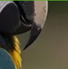









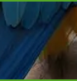
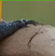


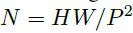
Example describing the ViT mechanism

Slide 10
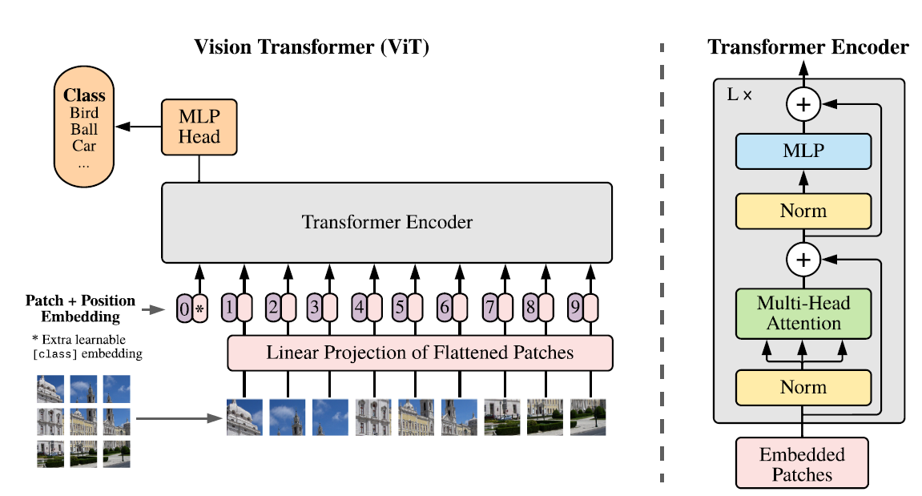
Vision Transformer model
ViT receives 2D image patches as input, instead of the standard 1D sequence of token embeddings.
A learnable embedding is prepended to the sequence of embedded patches, similar to BERT’s class token.
Classification head is implemented by MLP, with one hidden layer at pre-training.
Position embeddings are added to patch embeddings to retain positional information.
Inside the Transformer encoder, LayerNorm and Residual Connections are applied at every blocks for better training.
Essentially a FCN which outputs embeddings
Notes:
This is the structure of Vision Transformer proposed by the authors, its very similar to the standard vanilla transformer with a few modifications.
<Explain about BERT>
BERT - Bidirectional Encoder Representations from Transformers
Bidirectional approach to learn context from both sides of a token within a sentence
Key features
Bidirectional encoding
BERT reads text in both directions simultaneously
Helps in capturing deeper context for each word, considering the entire sentence for context
Masked Language Modeling
Trained by masking random words in sentences and asking the model to predict the masked words
Next Sentence Prediction
Also trains on a next-sentence prediction task, which helps it understand relationships between sentences
Fine-tuning for downstream tasks
BERT architecture, once pre-trained, can be fine-tuned for various NLP tasks such as text classification, named entity recognition, and sentiment analysis by adding simple output layers for specific tasks
BERT is similar to ViT because they both rely on self-attention mechanisms to capture relationships from the input. BERT models word-to-word whereas ViT models patch-to-patch relationships
<Explain about the positional embeddings in patches>
Self-attention is used to model the relationships between different parts of an image, treating it in a similar way of how transformer handles words in a sentence
Image divided into 16X16 patches -> each patch flattened into a 1D vector (similar to token in NLP) -> patch vectors linearly transformed to create embeddings
Describe about the LayerNorm and why it is applied at the Transformer Encoder block

Slide 11
Example describing the ViT mechanism
H
P
W
C=3
P

Slide 12
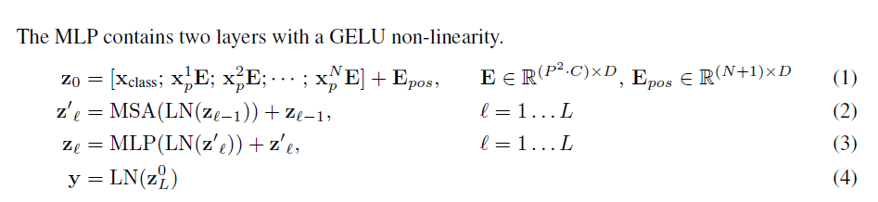
Inside Transformer encoder
The patch vectors are converted into input embeddings once they pass through the FCN.
Positional encodings are added to the input embeddings before it gets processed by the Transformer encoder
Inside the Transformer encoder, it goes through multiple stages of Multi-head self attention and MLP heads followed by skip-connections to retain the high-resolution information
N
Notes:
There’s input embedding into the patches, which is shown as matrix multiplication. In addition to it, there is positional encoding added to the input embeddings represented as E_pos
Inside the Transformer encoder, the input undergoes alternating layers of multiheaded self-attention and MLP blocks and LayerNorm is applied before every block, and residual connections after every block

Slide 13
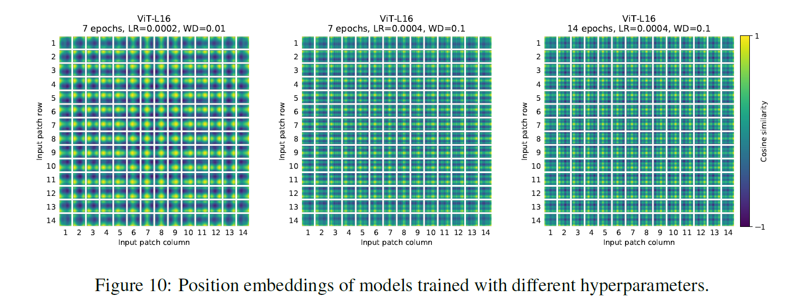
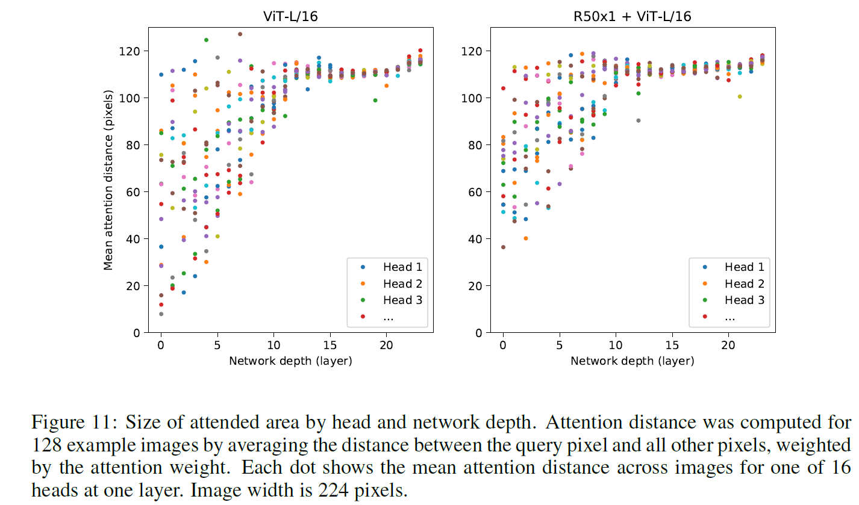
Deeper inspection of ViT model
Self attention allows ViT to integrate information across the entire image even in the lowest layers.
We compute the average distance in image space across which information is integrated , based on the attention weights. (analogous to receptive field size in a CNN)
Globally, it is observed that model attends to image regions that are semantically relevant for classification
Notes:
Also explain about axial attention and relative positional embedding.
<Explanation on Relative Positional Embedding>
Its an embedding method used in Transformers to allow the model to understand the relative positions to each other along with the absolute positions of the tokens in a sequence.
It is useful to understand the complex sequential dependencies
It encodes the relative distance between the tokens, rather than a fixed position for each token in the sequence
This allows for better handling of tasks with varying sequence lengths and focuses on the relationships between tokens more flexibly
Relative positional embedding allows the model to emphasize such connections without being bound by fixed positions, making it easier to generalize to sentences of varying structures and lengths.
<Explanation on Axial Attention>
Specialized form of self-attention used in Transformers, particularly designed to efficiently handle high-dimensional data, such as images or long sequences, by focusing attention across different axes or dimensions of the input data independently.
This approach significantly reduces the computational cost of self-attention on high-dimensional data without sacrificing too much of the contextual power that makes self-attention effective
Axial attention decomposes the attention across different dimensions or axes of the data
By focusing on one axis at a time, axial attention achieves better efficiency, with each attention step only attending over a smaller subset of elements in the sequence
Steps involved in Axial attention
Divide attention across axes
Stepwise attention application (for eg. In a 2D grid first apply row attention and then column attention)
Combining row and column attention
Axial attention have applications in Vision Transformers, Long-sequence processing and Video Transformers

Slide 14
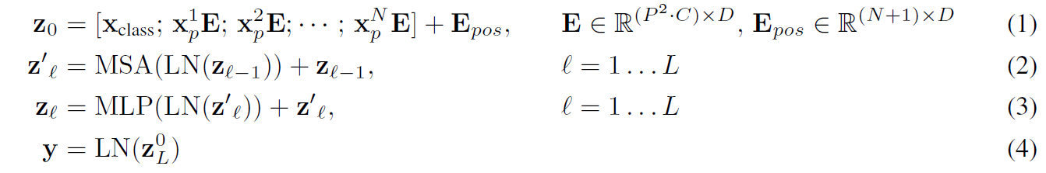
Inductive Bias and Fine Tuning
Vision Transformer has much less image-specific inductive bias than CNNs. Why ?
Because of its architecture…
Uses positional encoding instead of spatial structures enforced in convolutions
Self-attention’s mechanism’s flexibility
Fine-tuning at Higher resolution
Its better to fine-tune ViT at higher resolution than pre-training
Only place where there is inductive bias about the 2D structure manually injected!
Remove pre-trained prediction head and attach a zero initiated feed forward layer
Perform 2D interpolation of pre-trained position embeddings, according to their location in the original image
Fine tune to downstream tasks
Notes:
<Explanation on Inductive Bias>
What is Inductive Bias?
It’s model’s built-in preference or assumptions that influence how it generalizes from its training data to new, unseen data.
Since a model will always have limited training data, it uses inductive bias to fill in gaps by favoring certain kinds of patterns or relationships over others.
A models inductive bias heavily influences its generalization ability.
Appropriate inductive bias helps the model learn the true underlying structure of data.
It also helps in reducing overfitting (inductive bias can act as a form of regularization, preventing the model from overfitting to noise in training data)
<Explanation on why ViT has very less inductive bias>
It is because of the architecture of the transformer
Translational invariance
ViT processes an image by splitting it into patches, treating each patch as a token in a sequence, without explicitly capturing locality or translational invariance in the same way.
It has no built-in hierarchical structure
They treat each patch independently at the start
Global relations are learned through self-attention over patches, without the inductive hierarchy as imposed by the convolutional layers
Positional encoding instead of spatial structures
Positional encoding provides minimal inductive bias as compared to spatial continuity enforced by convolutions
<Explain why is fine-tuning at higher resolution is beneficial than pre-training>
It allows the model to capture more detailed information in images, improving its performance on certain tasks that require fine-grained details
When images are fine-tuned at higher resolution, each patch covers a smaller region of the image relative to its content, allowing the model to capture finer details that were blurred or compressed at lower resolutions
Fine-tuning at higher resolution helpful in tasks such as fine-grain classification, segmentation where small details are crucial, resolution enables the model to focus on subtler features.
During pre-training, the model learns general representations at a lower resolution
Refinement helps in better generalization, and adapt its learned features to capture details

Slide 15
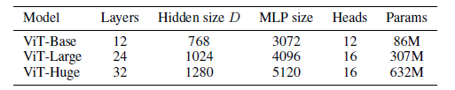
Experimental Setup
Authors evaluate the representation learning capabilities of ResNet, ViT and hybrid architectures.
ViT attains state-of-the-art on most recognition benchmarks @ lower pre-training cost (Advantage)
Exploring model’s scalability
Models trained on these datasets are transferred to several benchmark tasks such as CIFAR-10/100, Oxford-IIIT Pets, Oxford-Flowers-102, VTAB classification suite etc.
Base ViT configurations derived from BERT
For CNNs, they used ResNets and replaced Batch normalization with Group normalization
For Hybrid architectures, intermediate feature maps were fed to ViT with patch size of one pixel.
Dataset | No. of Classes | No. of Images
ILSVRC-2012 ImageNet | 1000 | 1.3 Million
ImageNet-21k | 21k | 14 Million
JFT | 18k | 303 Million
Model introduced by authors
Notes:
<Explanation on VTAB Classification Suite>
Visual Task Adaptive Benchmark
It’s a diverse and challenging suite of tasks, designed to evaluate general visual representations
Its an evaluation method to test the representation learning
The benchmark consists of 19 tasks, drawn from variety of domains and with various semantics
It can also be used to evaluate techniques, other than representation learning, that improve performance across a variety of tasks such as architectures, pre-processing functions or optimizers
<Explanation on BERT architecture>
BiDirectional Encoder representation from Transformer
Learns context from both sides of a token within a sentence
Helps in capturing deeper context for each word, considering the entire sentence for context
Trained by masking random words in sentences and asking the model to predict the masked words
BERT architecture once fine-tuned, can be used for various NLP tasks such as text classification, sentiment analysis by just adding output layers for specific tasks

Slide 16
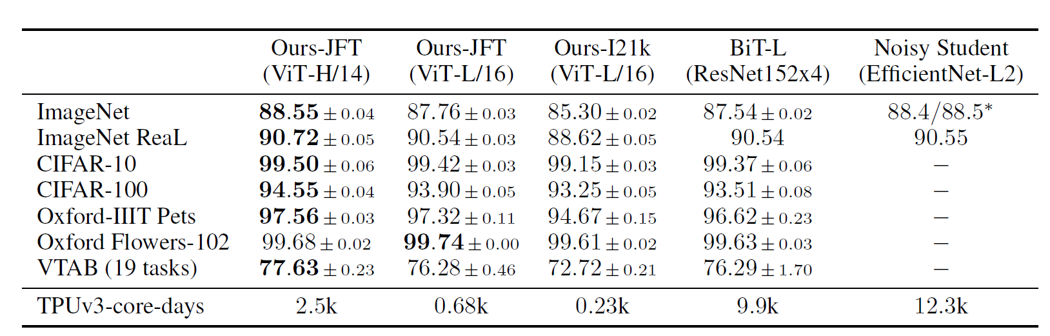
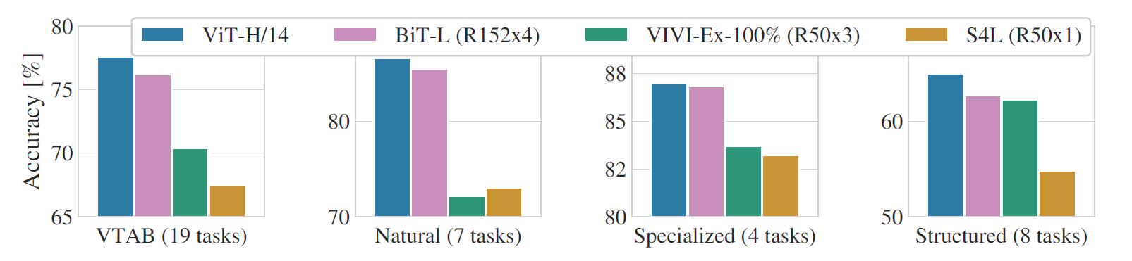
Observation : Comparison with the State-of-the-art
Authors compared ViT-H/14 and ViT-L/16 to state-of-the-art CNNs.
Comparison points were Big Transfer (performs supervised learning with large ResNets) and Noisy Student,
Noisy Student is state-of-the-art on ImageNet and BiT-L.
Models trained on TPUv3 hardware.
ViT models pre-trained on the JFT-300M dataset outperforms ResNet based baselines on all datasets, while taking substantially less computational sources
Notes:
<Explain Big Transfer>
BiT – Big Transfer
Applied supervised Transfer learning using large ResNet models pre-trained on massive datasets to improve performance on a wide range of downstream visual tasks
Special focus on large-scale pre-trained models to leverage the transfer of learned representations to new, potentially smaller datasets in a highly efficient and effective way
BiT model learns to adapt its general visual knowledge to more specific classes and contexts without requiring a large volume of labelled data for a new task.
<Explain about the Noisy Student framework>
Its an approach for semi-supervised learning that improves model performance by leveraging both labeled and unlabeled data with a teacher-student paradigm, noise injection and self-training.
Combines self-training with data augmentation and noise injection to improve model’s performance, in scenarios where labeled data is limited but unlabeled data is in plenty
Model starts with training the teacher model with labeled data
Teacher model used to generate pseudo-labels for unlabeled data, providing target labels that are used to train the student model
Student model is deliberately trained with various types of noise to make it more robust
Noise can be in the form of data augmentation, dropout or stochastic depth
After training the initial student model, it can then become the new teacher model for the next round of training
This model outperforms the traditional supervised models, especially on tasks with limited labeled data, by learning from both labeled and pseudo-labeled examples

Slide 17
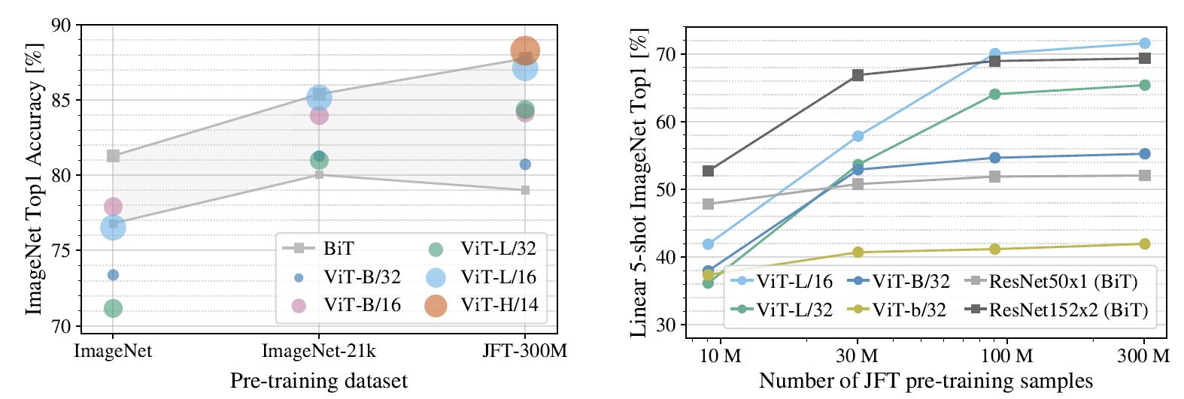
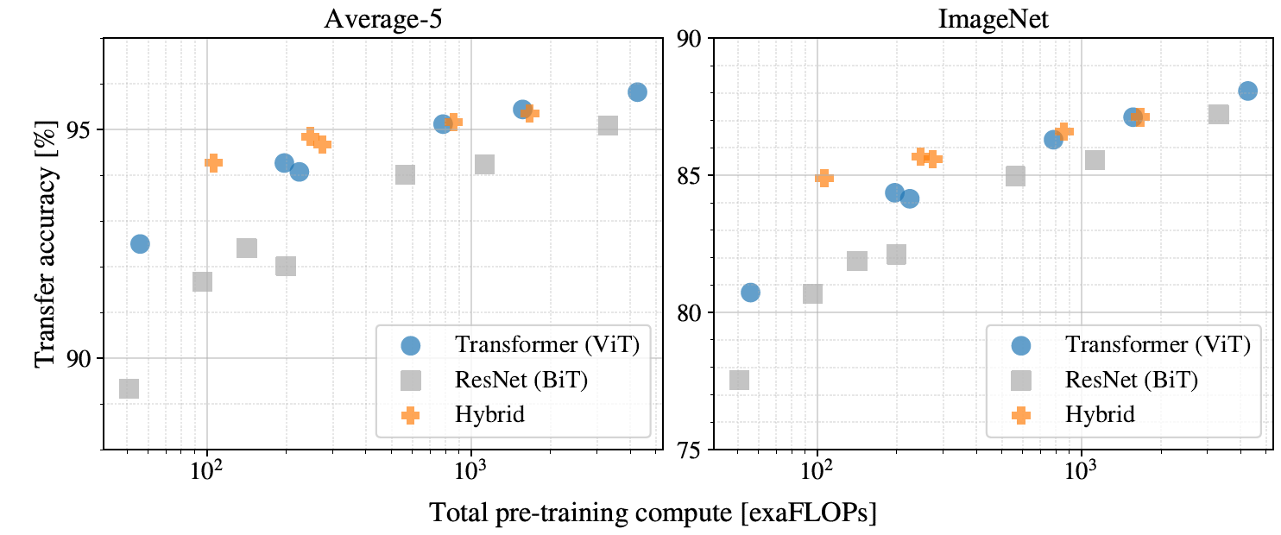
Performance vs. Pre-training compute for different Architectures
ViT models are pre-trained on datasets with increasing size such as ImageNet, ImageNet-21k, and JFT-300M
Regularization parameters are optimized to boost the performance on smaller datasets.
Observation : ViT-Large models underperform compared to ViT-Base models in smaller datasets
Full benefit of larger models is only seen in JFT 300M.
Models were trained on random subsets of 9M, 30M and 90M as well as full JFT-300M dataset.
In order to assess the model’s intrinsic properties, regularization was not applied on smaller subsets and same hyperparameters were used for all the datasets
Observation : Vision Transformers overfit more than ResNets with comparable computational costs on smaller datasets.
Notes:
<Explain the various regularization techniques>
Weight decay, dropout and label smoothing
* Weight decay
Penalizes large weights in the model by adding a term to the loss function proportional to the square of weights
Term is controlled by a hyperparameter, which determines the strength of the penalty
Discourages the model to learn excessively large weights, which can lead to overfitting
Dropout
During each training iteration, a fraction of neurons in a layer is randomly set to zero, with a probability between 0.2 and 0.5
Forces the model to learn redundant, distributed representations by preventing it from relying too heavily on a single neuron
Makes the model less sensitive to specific neurons, reducing overfitting
Label smoothing
Applied to the labels in the classification task, where one hot target labels are slightly softened by distributing a small portion of probability mass away from the true label to other classes
Helps in preventing overconfident predictions by encouraging the model to output less extreme probabilities
Makes the model more stable during training and can help prevent it from becoming overly confident, which is particularly useful in scenarios with noisy labels or imbalanced data
After performing this study, the authors observed that inductive bias is useful for smaller datasets, ie. Learning relevant patterns directly from data is sufficient, and sometimes even beneficial.
<Explanation on few-shot linear accuracy> that is used as a metric
It is a metric used to evaluate how well a pre-trained vision transformer model can adapt to new tasks with limited data.
In few-shot learning, the model is given only a small number of labeled examples per class for a new task.
The model’s embeddings or features from pre-training are frozen, and a simple linear classifier is trained on top of these features with the limited labeled data. The linear accuracy is then calculated as the accuracy of this classifier on the validation set.
This metric is useful because it measures generalization ability ie. How well the model’s learned representations can generalize to new classes with minimal fine-tuning.
Also, the feature quality ie. It suggests that the ViT has learned high-quality, transferable features that can effectively represent various tasks, even with sparse data.
<Explanation on exaFLOPs>
* It refers to the vast amount of computational power used to train the model.
* One exaflop equals 10^18 floating-point operations per second, and ViTs often require hundreds or even thousands of exaFLOPs over long training periods due to their heavy reliance on large datasets and deep layers.

Slide 18
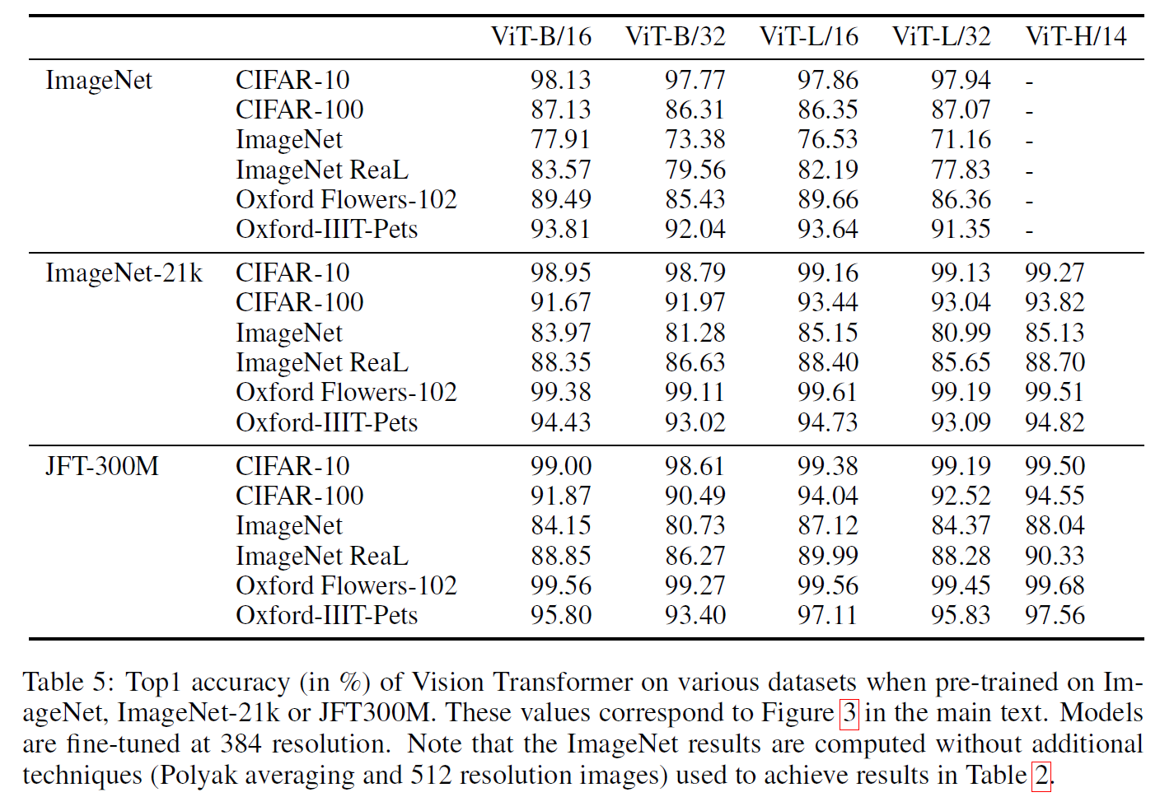
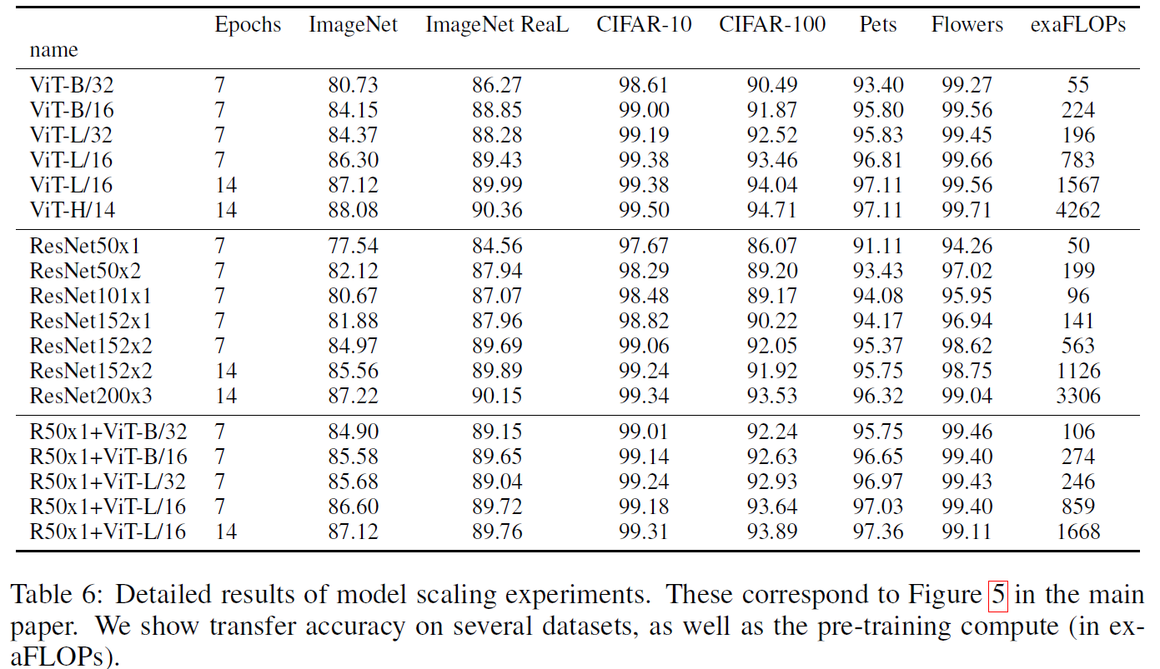
Conclusion
The authors explored the direct application of Transformers into image recognition
The strategy works well when coupled with pre-training on large datasets
Vision Transformers exhibit strong performance with fewer inductive biases as compared to CNNs
But, they require substantial amounts of training data to achieve state of the art level of success

Slide 19
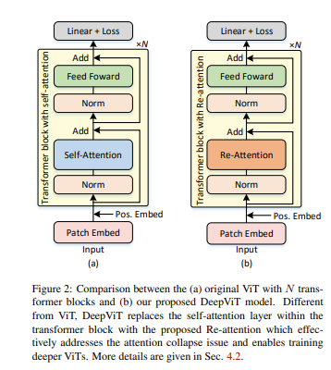
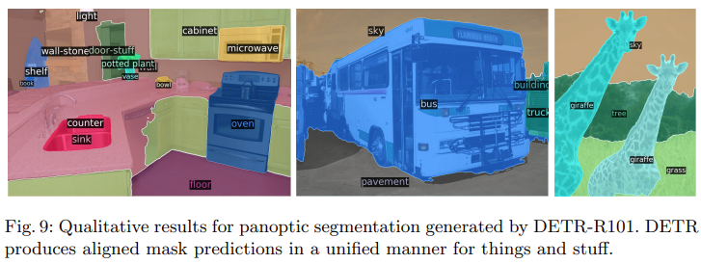
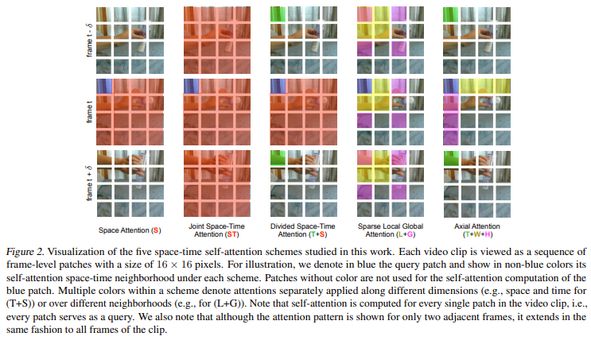
Applications/ Future work of this Research
With this research, there are also some experiments performed by other researchers on using Transformers to perform end-to-end object detection using Transformers
Applying Vision Transformers in Videos , and to recognize actions in videos
Semantic segmentation
Towards Deeper Vision Transformers
Notes:
<Describe about the DETR, used to perform semantic segmentation / object detection>
DETR – Detection Transformer
Is a new design for object detection systems based on transformers and bipartite matching loss for direct set prediction
This approach achieves comparable results to an optimized R-CNN baseline on the challenging COCO dataset.
It is straightforward to implement and has flexible architecture
Bipartite matching loss – the matching loss function proposed in the paper uniquely assigns predictions to a ground truth object and is invariant to a permutation of predicted objects.
This uses a traditional CNN backbone to learn 2D representation of an input image; model flattens it with positional encoding before passing it to a transformer encoder; transformer decoder then takes as input a small fixed number of learned positional embeddings, which are called object queries and additionally attends to the encoder output.
Each output embedding is passed to a shared feed forward network which predicts either a detection (class/ bounding box) or “no object” class
<Describe the mechanism of Axial attention, and how is it useful for action recognition in videos>
Applying Vision Transformers in Videos, and to recognize actions in videos uses the concept of Space-Time transformer
It consists of spatial and temporal processing
Temporal processing captures dependencies across frames, and uses multi-head attention to model how objects and motion change over consecutive frames
Temporal attention mechanism allows the model to look back and forth across frames, understanding how individual actions progress
Use multi-head attention to model how objects and motion change over consecutive frames, enabling the detection of complex actions that unfold over time
DeepViT
It introduces re-attention mechanism to the existing transformer to re-generate the attention maps to increase their diversity at different layers with negligible computation and memory costs. Makes it possible to train deeper ViT models
But Why ? Because performance of ViTs saturate fast when scaled to be deeper
Scaling difficulty is caused by the attention collapse issue, the feature maps tend to be identical in the top layers of deep ViT models and the self-attention mechanism fails to learn effective concepts for representation learning and hinders the model from getting expected performance gain.

Slide 20
References
Dosovitskiy et al, An Image is worth 16X16 words: Transformers for image recognition at scale, ICLR 2021
Wasawani et al, Attention is all you need, 31st Conference on Neural Information Processing Systems (NIPS) 2017
Carion et al, End-to-end Object Detection with Transformers, Facebook AI, 2020
Zhou et al, DeepViT: Towards deeper Vision Transformer
Visual Computing Institute, RWTH Aachen (ML and Computer Vision lecture slides)

Slide 21
Thank you for your attention!
Ashwin Chakravartula
ashwin.chakravartula@rwth-aachen.de
13.11.2024

